Slide 1
Lab 1
Introduction to Communication System

Slide 2
EXPERIMENT NO-1
AIM: Introduction to Spectrum analyzer (Dynamic Signal Analyzer in NI MyDAQ).
Basics of Filters and their signal output, Concept of Bandwidth

Slide 3
Spectrum Analyzer
The electronic instrument, used for analyzing waves in frequency domain is called spectrum analyzer. Basically, it displays the energy distribution of a signal on its CRT screen. Here, x-axis represents frequency and y-axis represents the amplitude.
Types of Spectrum Analyzers
Filter Bank Spectrum Analyzer
Superheterodyne Spectrum Analyzer

Slide 4
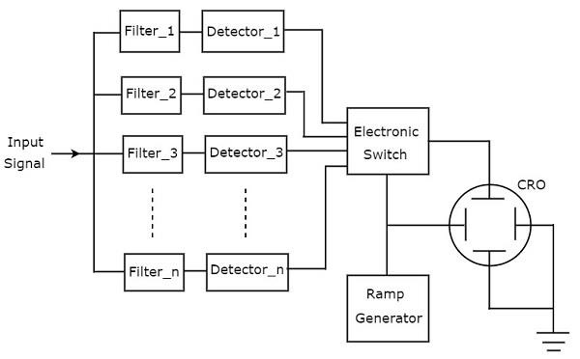
Block diagram of filter bank spectrum analyzer : The spectrum analyzer, used for analyzing the signals are of AF range is called filter bank spectrum analyzer, or real time spectrum analyzer because it shows (displays) any variations in all input frequencies.
It has a set of band pass filters and each one is designed for allowing a specific band of frequencies. The output of each band pass filter is given to a corresponding detector.
All the detector outputs are connected to electronic switch. This switch allows the detector outputs sequentially to the vertical deflection plate of CRO. So, CRO displays the frequency spectrum of AF signal on its CRT screen.

Slide 5
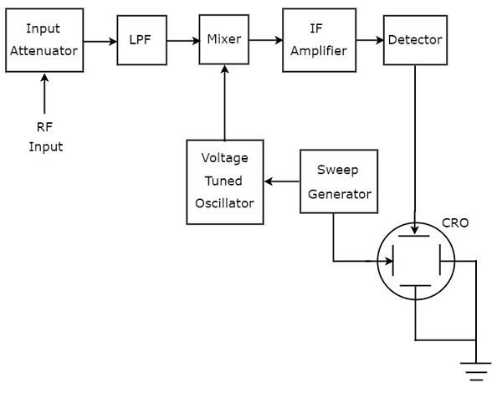
Block diagram of superheterodyne spectrum analyzer: The spectrum analyzer, used for analyzing the signals are of RF range is called superheterodyne spectrum analyzer. Its block diagram is shown in below figure.
The RF signal, which is to be analyzed is applied to input attenuator. If the signal amplitude is too large, then it can be attenuated by an input attenuator.
Low Pass Filter (LPF) allows only the frequency components that are less than the cut-off frequency.
Mixer gets the inputs from Low pass filter and voltage tuned oscillator. It produces an output, which is the difference of frequencies of the two signals that are applied to it.
IF amplifier amplifies the Intermediate Frequency (IF) signal, i.e., the output of mixer. The amplified IF signal is applied to detector.
The output of detector is given to vertical deflection plate of CRO. So, CRO displays the frequency spectrum of RF signal on its CRT screen.

Slide 6
Dynamic Signal Analyzer
The NI ELVISmx Dynamic Signal Analyzer (DSA) performs a frequency domain transform of the AI or Audio Input waveform measurement. It can either continuously make measurements
or make a single scan. You can also apply various window and filtering options to the signal.
This instrument has the following measurement parameters:
• Source Channel: AI 0 and AI 1; Audio Input Left and Audio Input Right
• Voltage Range:
– For AI channels: ±10 V, ±2 V
– For Audio Input channels: ±2 V

Slide 7
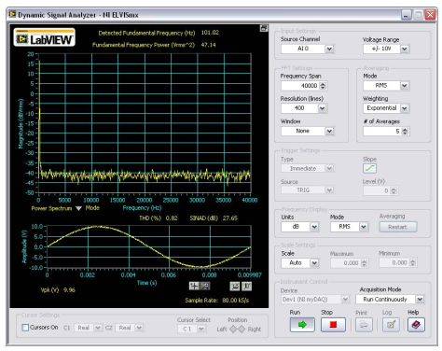
Dynamic Signal Analyzer

Slide 8
Filter
A filter is a circuit capable of passing (or amplifying) certain frequencies while attenuating other frequencies. Thus, a filter can extract important frequencies from signals that also contain undesirable or irrelevant frequencies.
Low pass filter(LPF) – Allows low frequencies
High pass filter(HPF) – Allows high frequencies
Band pass filter(BPF) – Allows band of frequencies
Band reject filter(BRF) – Rejects band of frequencies
All pass filter – Allows all frequencies but with a phase shift

Slide 9
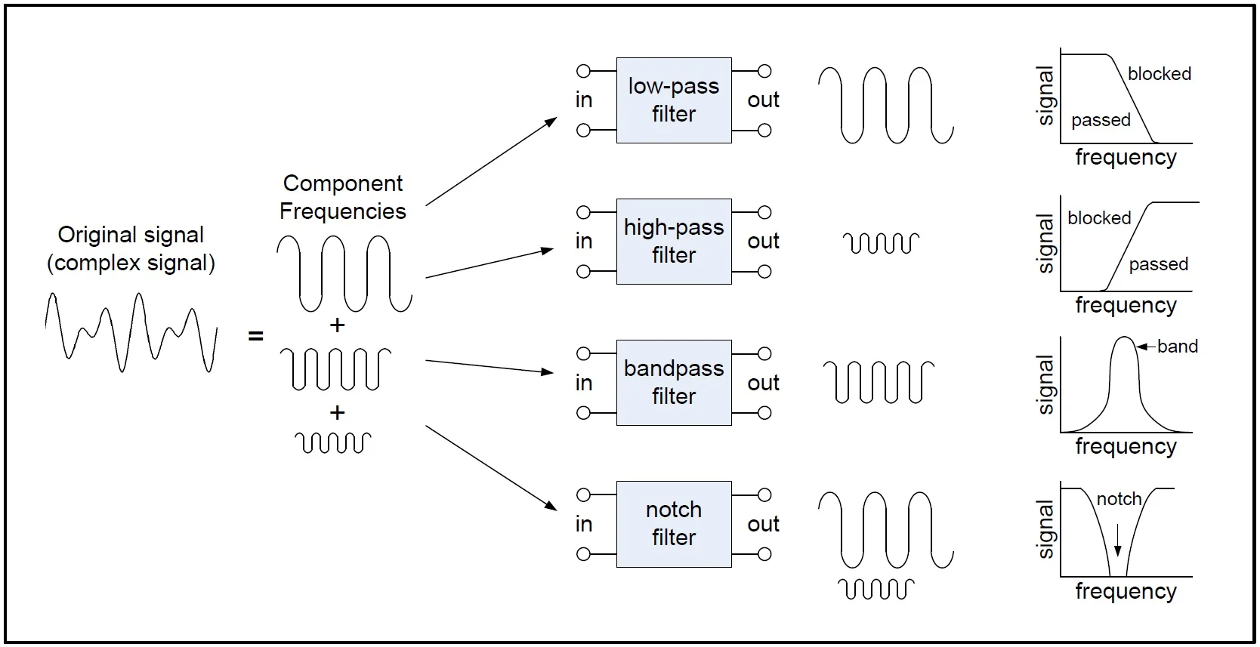
Types of filter:

Slide 10
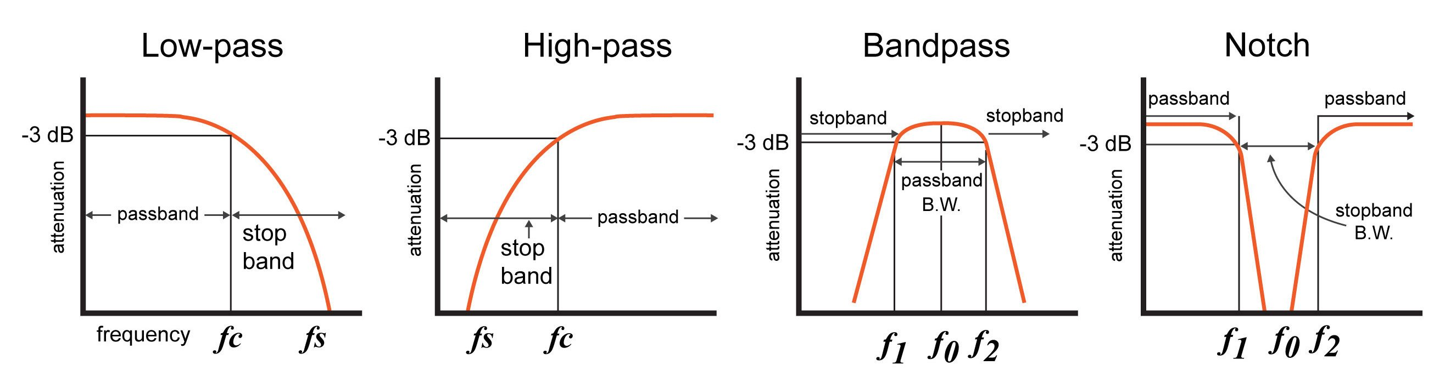
Types of filter:

Slide 11
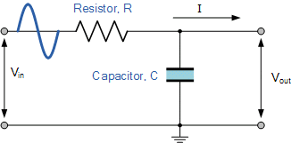
Passive Low Pass Filter
In low frequency applications (up to 100kHz), passive filters are generally constructed using simple RC (Resistor-Capacitor) networks.
while higher frequency filters (above 100kHz) are usually made from RLC (Resistor-Inductor-Capacitor) components.
Passive filters are made up of passive components such as resistors, capacitors and inductors and have no amplifying elements (transistors, op-amps, etc.) so have no signal gain, therefore their output level is always less than the input.

Slide 12
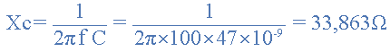
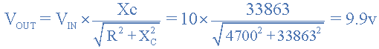
Example-1) A Low Pass Filter circuit consisting of a resistor of 4k7Ω in series with a capacitor of 47nF is connected across a 10v sinusoidal supply. Calculate the output voltage ( VOUT ) at a frequency of 100Hz and again at frequency of 10,000Hz or 10kHz.

Slide 13
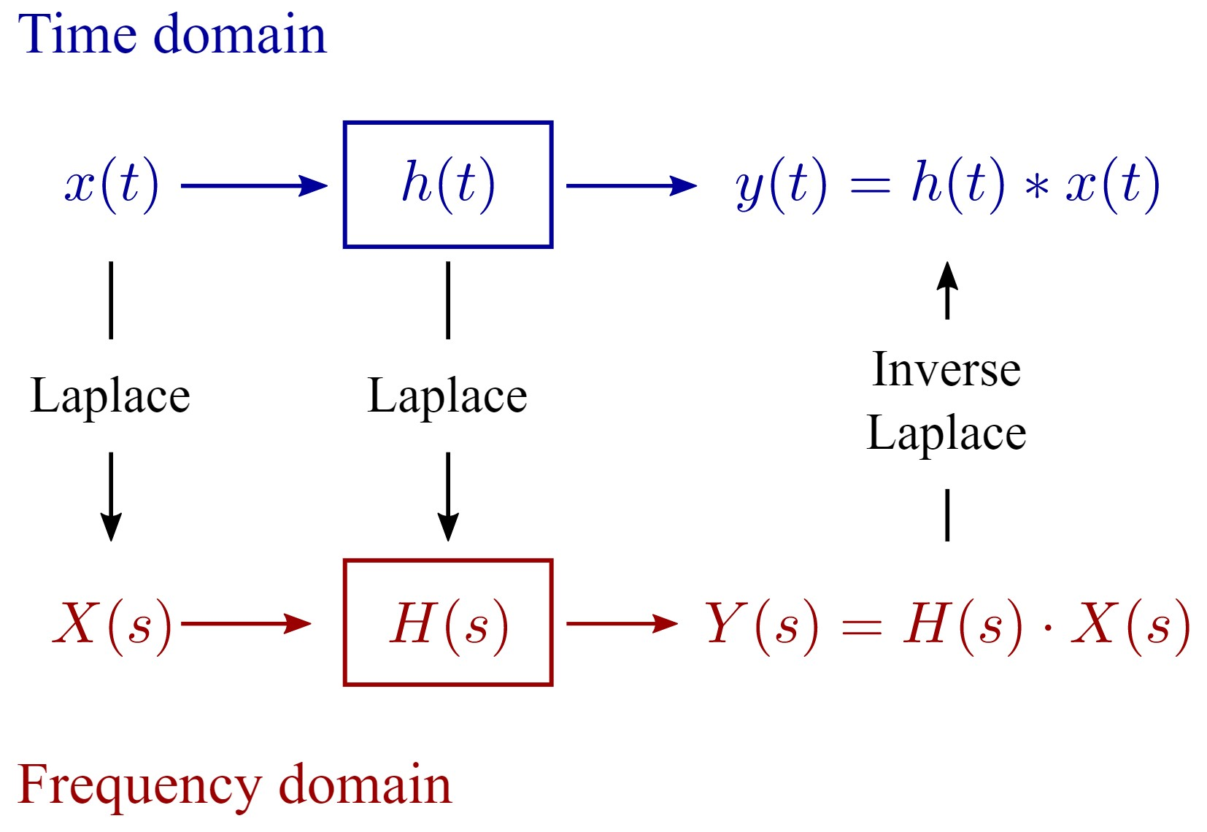

Slide 14
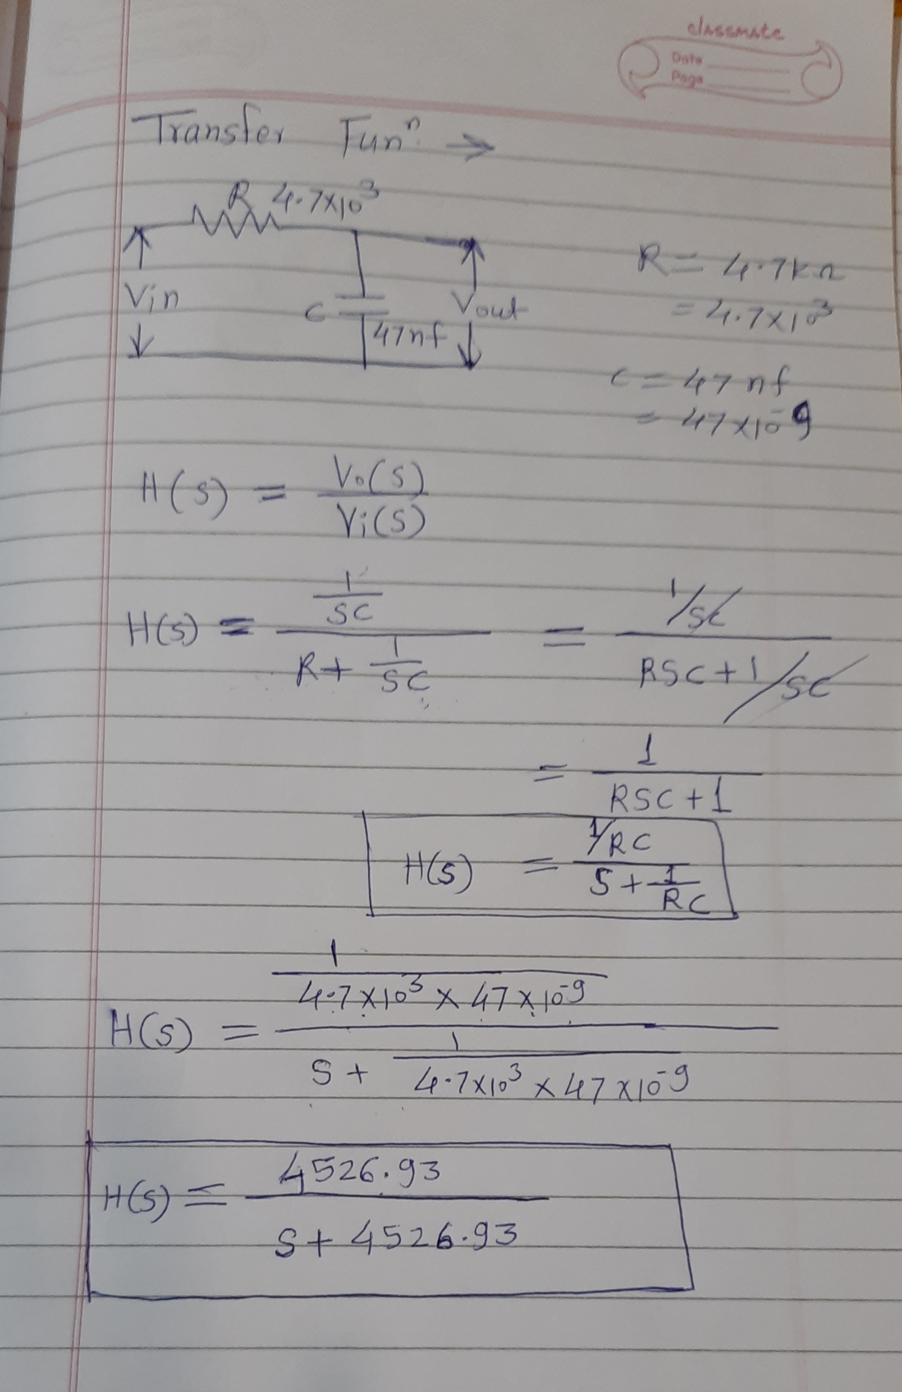
Transfer Function consider same example-1

Slide 15
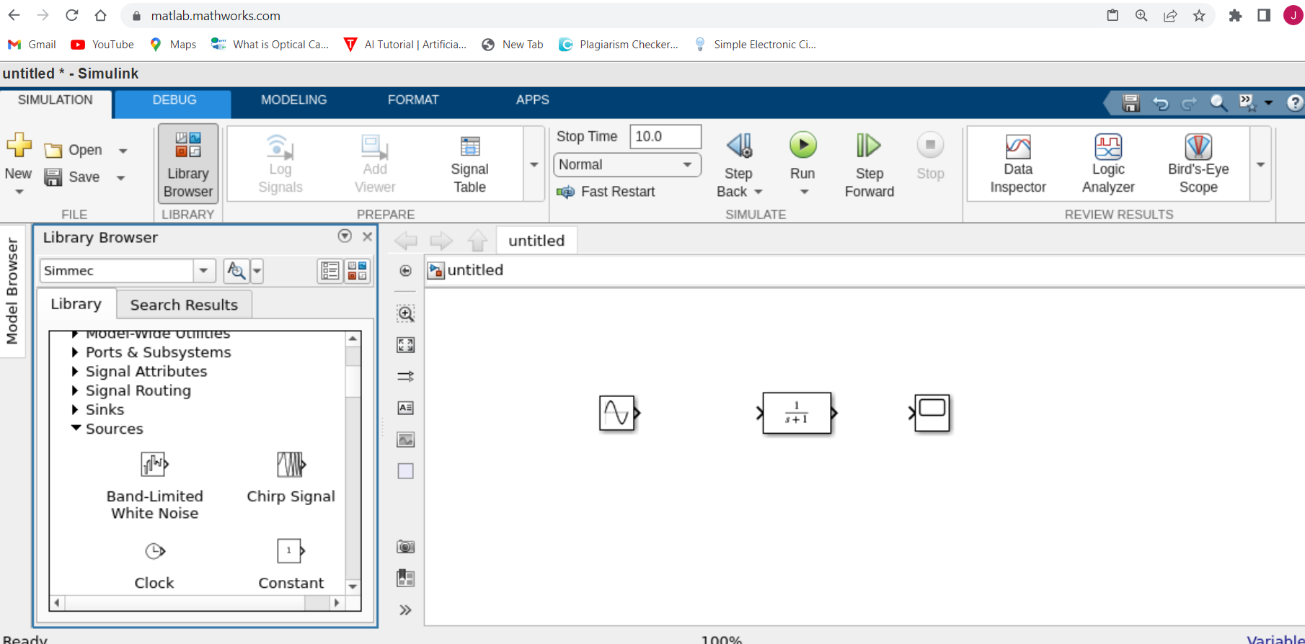
Requirement: MATLAB Simulink

Slide 16
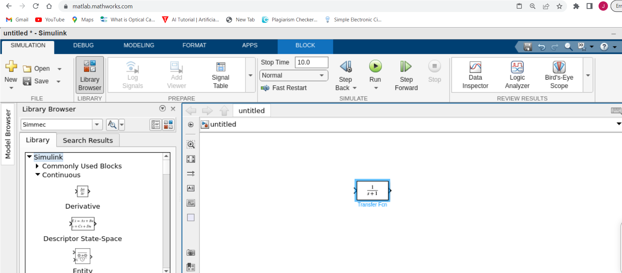
MATLAB Simulink

Slide 17
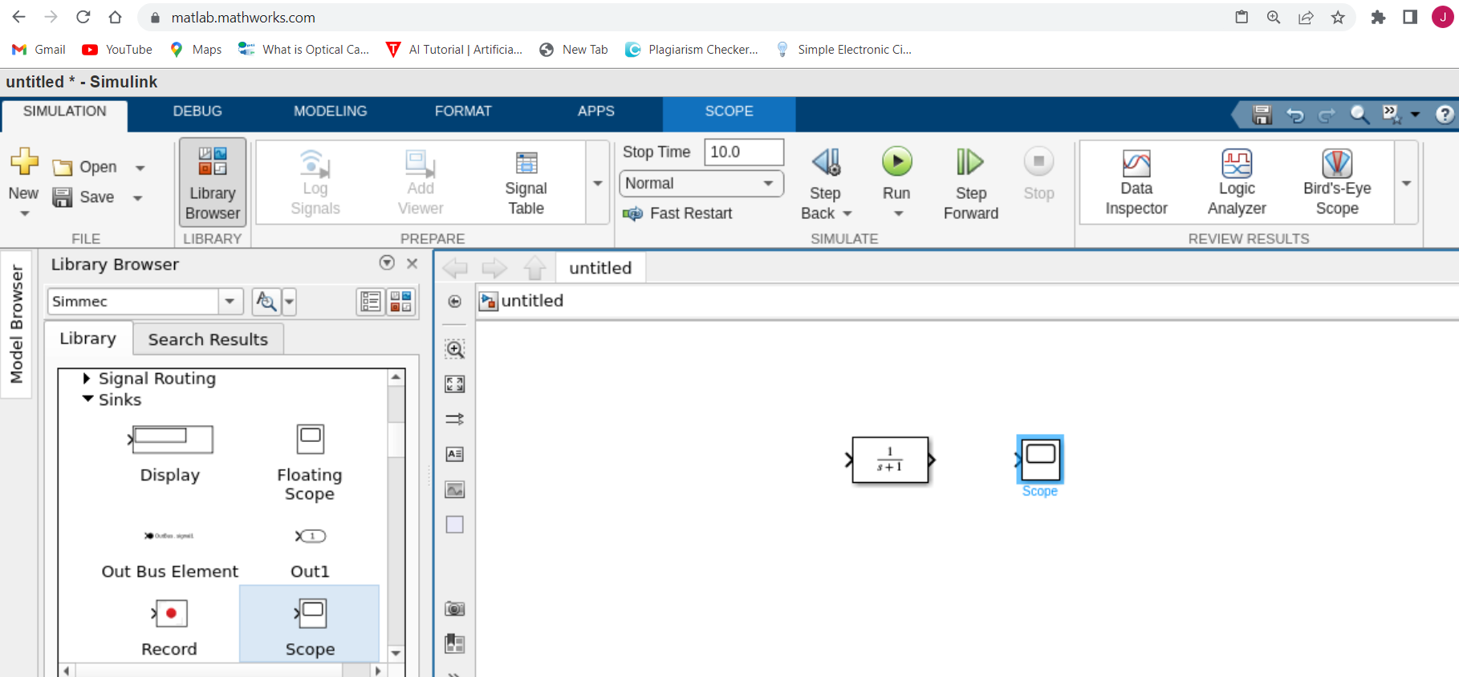
MATLAB Simulink

Slide 18
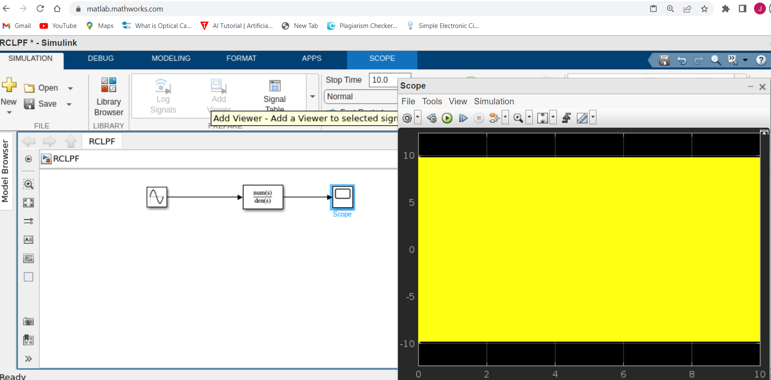
F= 100Hz, Vout= 9.9v

Slide 19
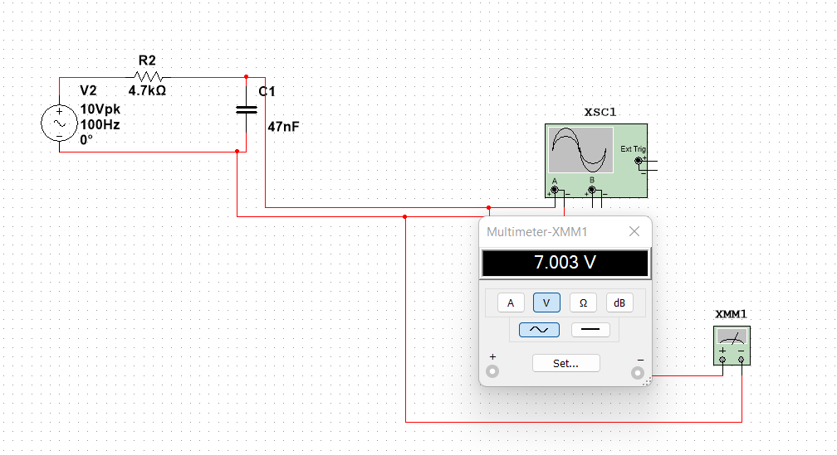
Optional: On Multisim:

Slide 20
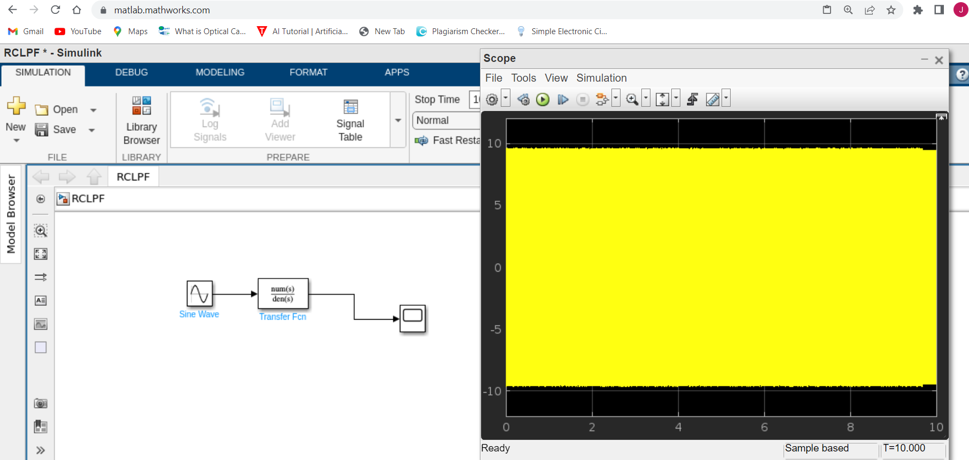
F= 200Hz

Slide 21
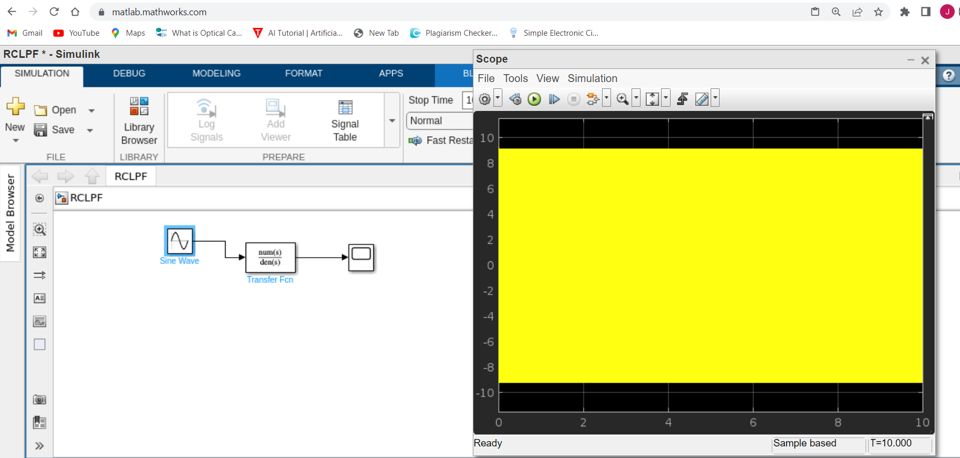
F=300

Slide 22
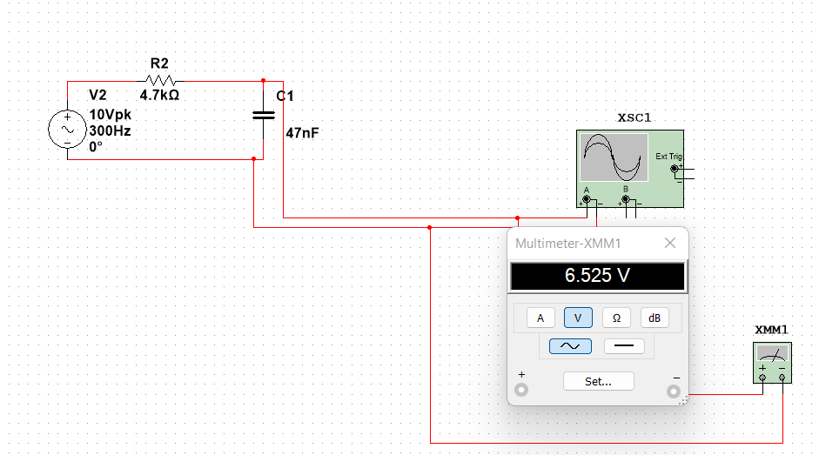
On Multisim

Slide 23
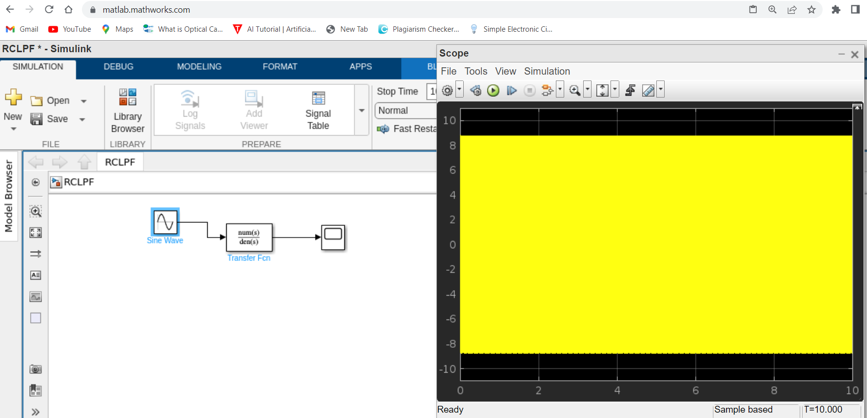
F= 400

Slide 24

F= 500Hz

Slide 25

F=600

Slide 26
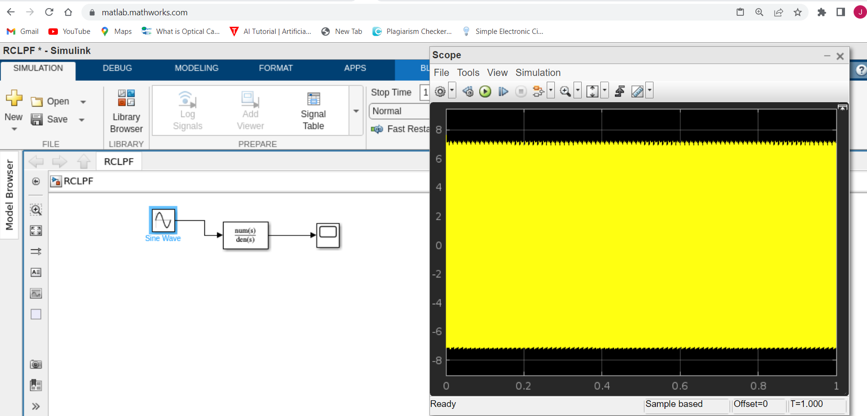
F=700

Slide 27

F=800

Slide 28

F=900

Slide 29

F=1000

Slide 30
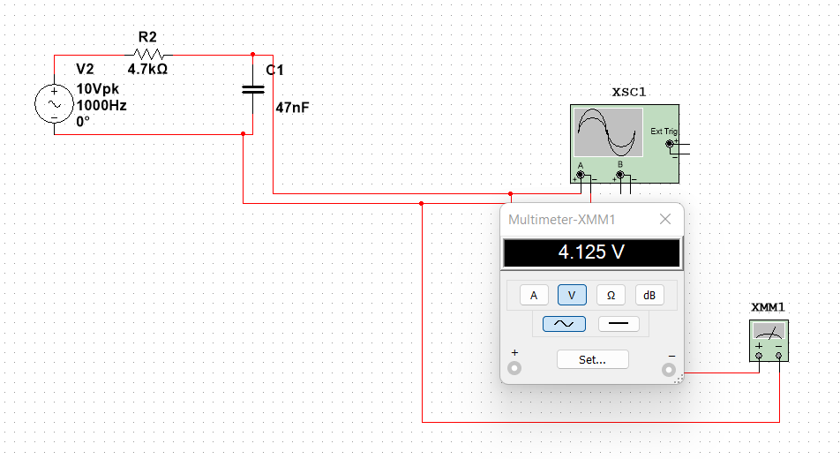
On Multisim

Slide 31
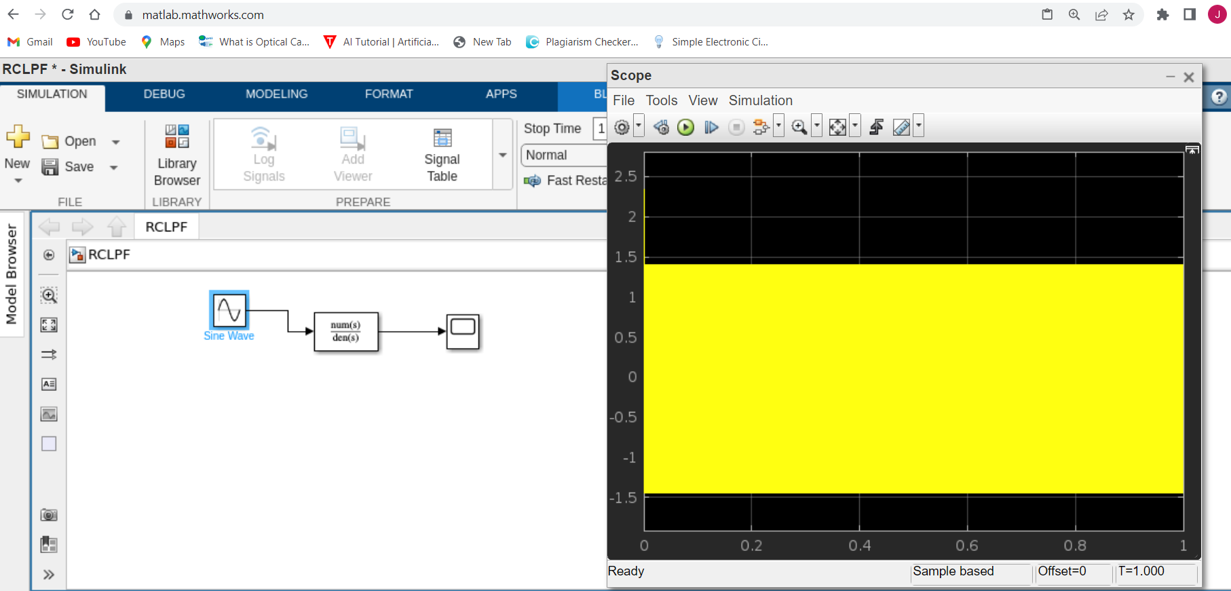
F=5000

Slide 32
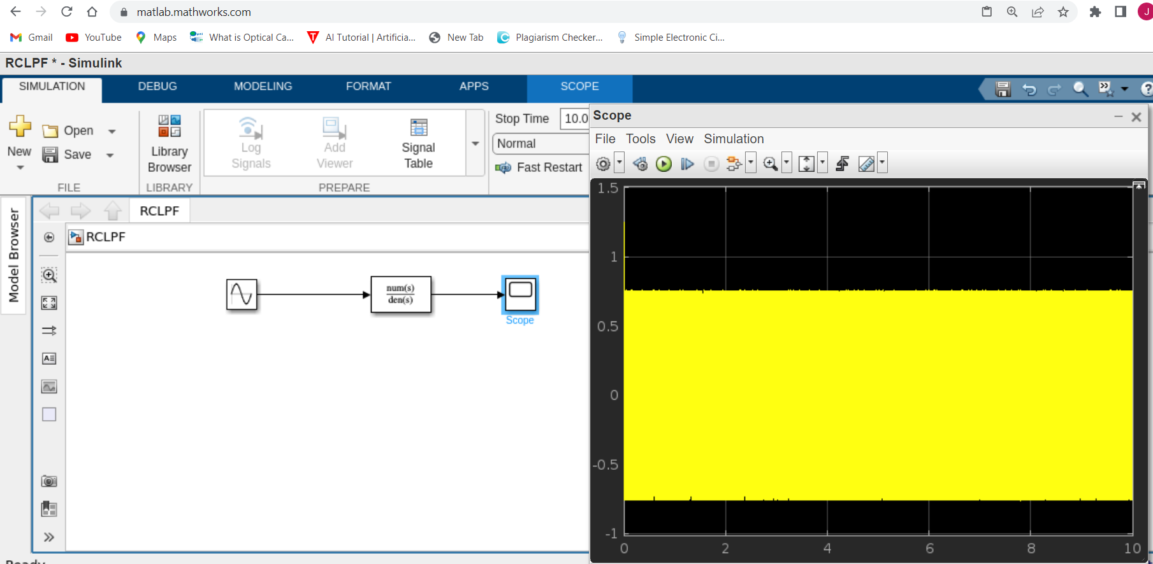
F= 10,000Hz Vout= 0.718

Slide 33
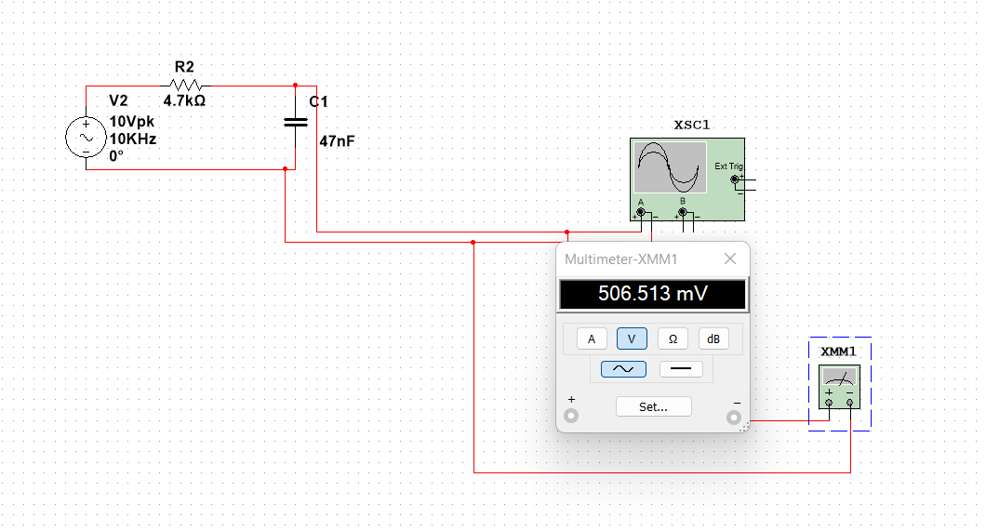
RC LPF on Multisim When input voltage is 10V at 10KHz frequency Vout=0.5065

Slide 34
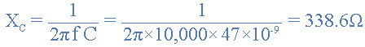
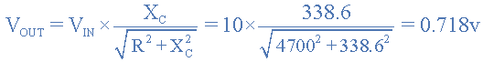
Voltage Output at a Frequency of 10,000Hz (10kHz).

Slide 35
Frequency Response
We can see from the results above, that as the frequency applied to the RC network increases from 100Hz to 10kHz, the voltage dropped across the capacitor and therefore the output voltage ( V_{OUT} ) from the circuit decreases from 9.9v to 0.718v.
By plotting the networks output voltage against different values of input frequency, the Frequency Response Curve or Bode Plot function of the low pass filter circuit can be found, as shown below.

Slide 36
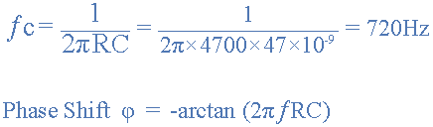
Cut-off Frequency and Phase Shift
It means that RC LPF will block the signal with 720 Hz or more
Signals with 720 Hz and below will pass easily through the filter.
Then for our simple example of a “Low Pass Filter” circuit above, the cut-off frequency (ƒc) is given as 720Hz with an output voltage of 70.7% of the input voltage value and a phase shift angle of -45º.

Slide 37
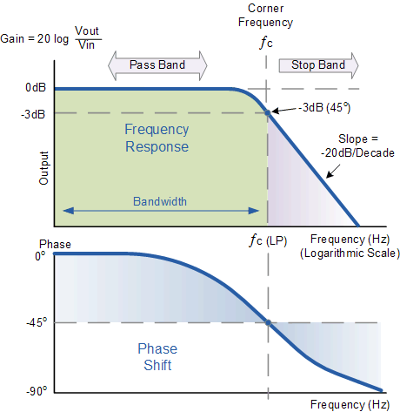
Frequency Response of a 1st-order Low Pass Filter
Ref: [1]

Slide 38
Example 2- Transfer Function:
Consider,
R = 10 KΩ and C= 1 microfarad for RC LPF calculate T.F=?
= 1/0.01

Slide 39
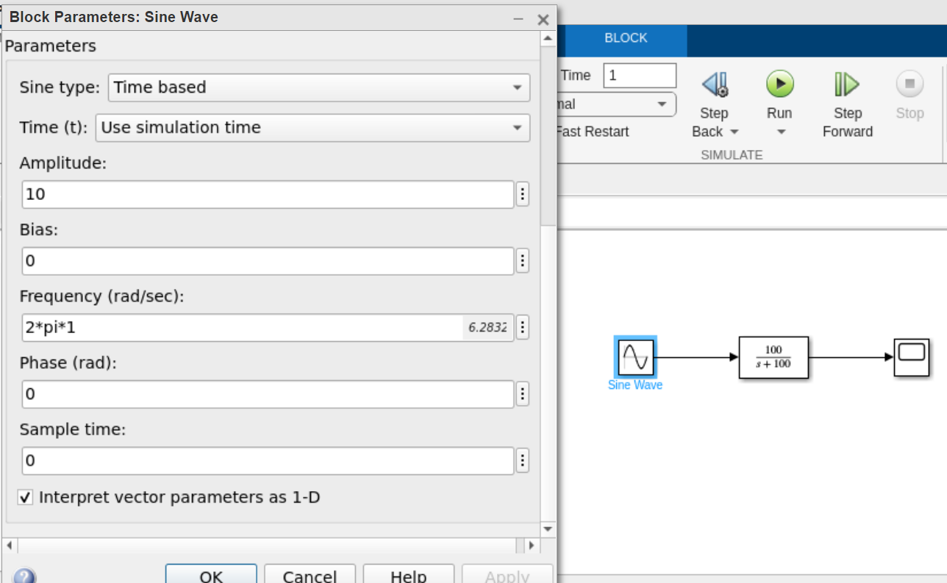
Input frequency: 1 Hz

Slide 40
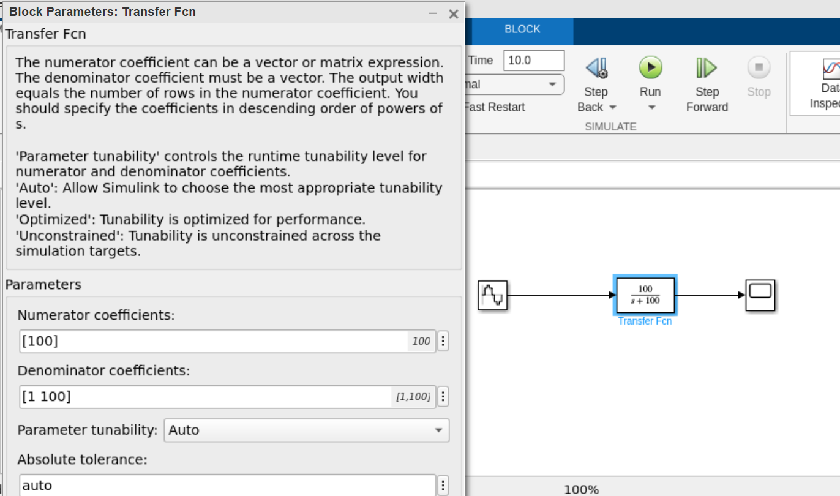
Parameters for TF:

Slide 41
R= 10Kohm, c=1microfarad,Vin 10 V, Frequency= 1Hz
Xc = 159154.94
Vout = 10 x 0.998 = 9.98v

Slide 42
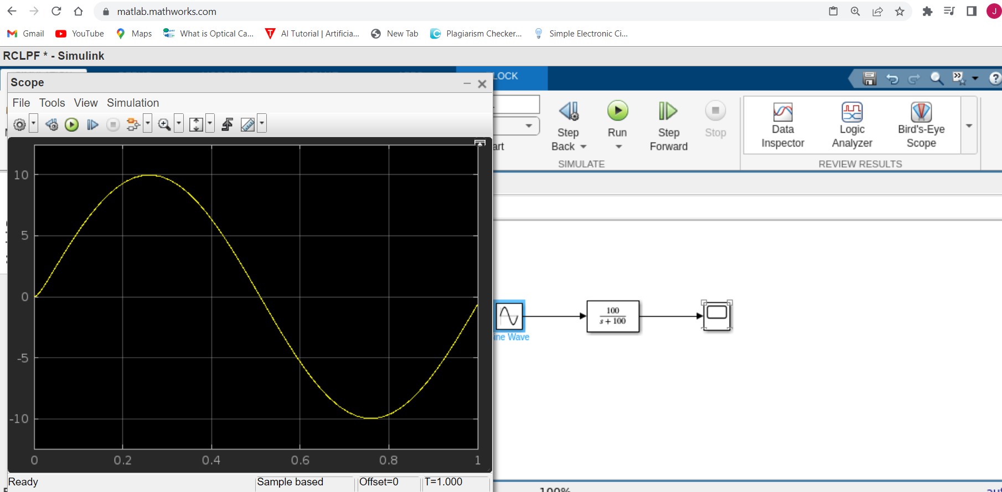
When the frequency is 1Hz Output voltage approximately 10V

Slide 43
R= 10Kohm, c=1microfarad,Vin 10 V, Frequency= 10Hz
Xc = 15915.494
Vout = 10 x 0.8467 = 8.467v

Slide 44
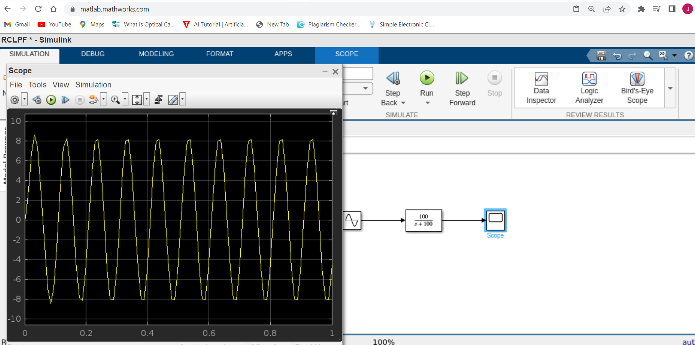
When the frequency is 10Hz Output voltage = 8.467V

Slide 45
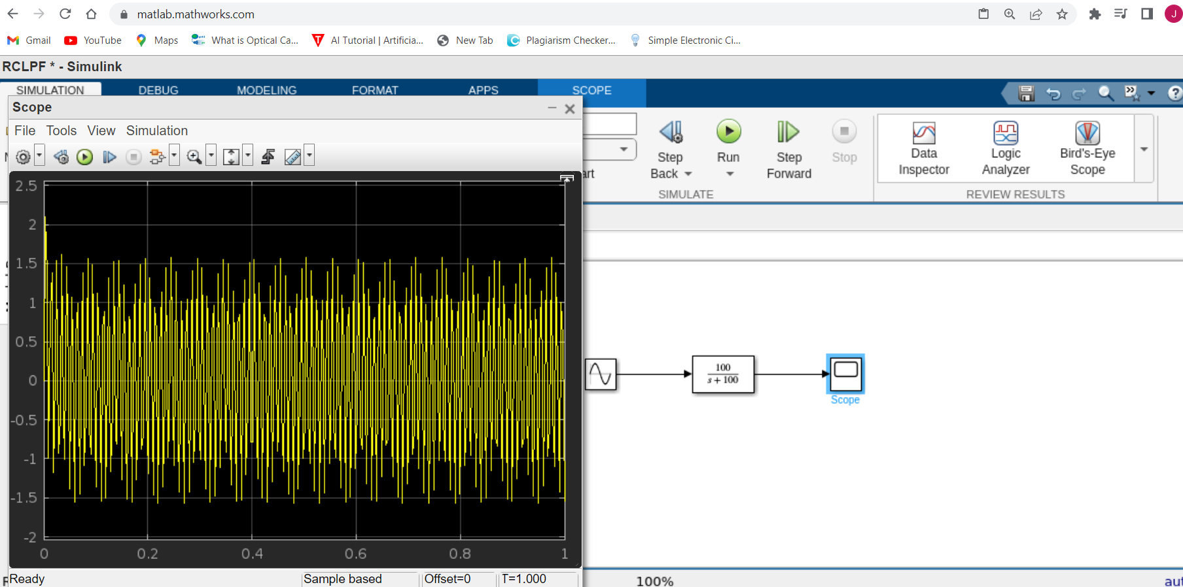
R= 10Kohm, c=1microfarad,Vin 10 V, Frequency= 100Hz Vout=?

Slide 46
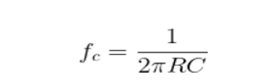
Cut-off frequency:
= 1/ 2*pi* 10K*1microfarad
Fc = 15.91 Hz
It means that RC LPF will block the signal with 15.91 Hz or more
Signals with 15.91 Hz and below will pass easily through the filter.

Slide 47
References:
[1] https://www.electronics-tutorials.ws/filter/filter_2.html
[2]https://www.tutorialspoint.com/electronic_measuring_instruments/electronic_measuring_instruments_spectrum_analyzers.htm
[3] https://www.allaboutcircuits.com/technical-articles/an-introduction-to-filters/
[4] https://www.youtube.com/watch?v=MNcu3TfPPQ8
[5] https://resources.pcb.cadence.com/blog/2021-simplify-rlc-circuit-analysis-with-the-rlc-transfer-function
[6] https://www.youtube.com/watch?v=zsnXcKj1MBc
[7] “B.P.Lathi”, Modern Digital and Analog Communication Systems Page no. 104,105

Slide 48
Thank you

